Slide 1

Air Quality Crisis in India
Understanding AQI patterns across states and cities

Slide 2
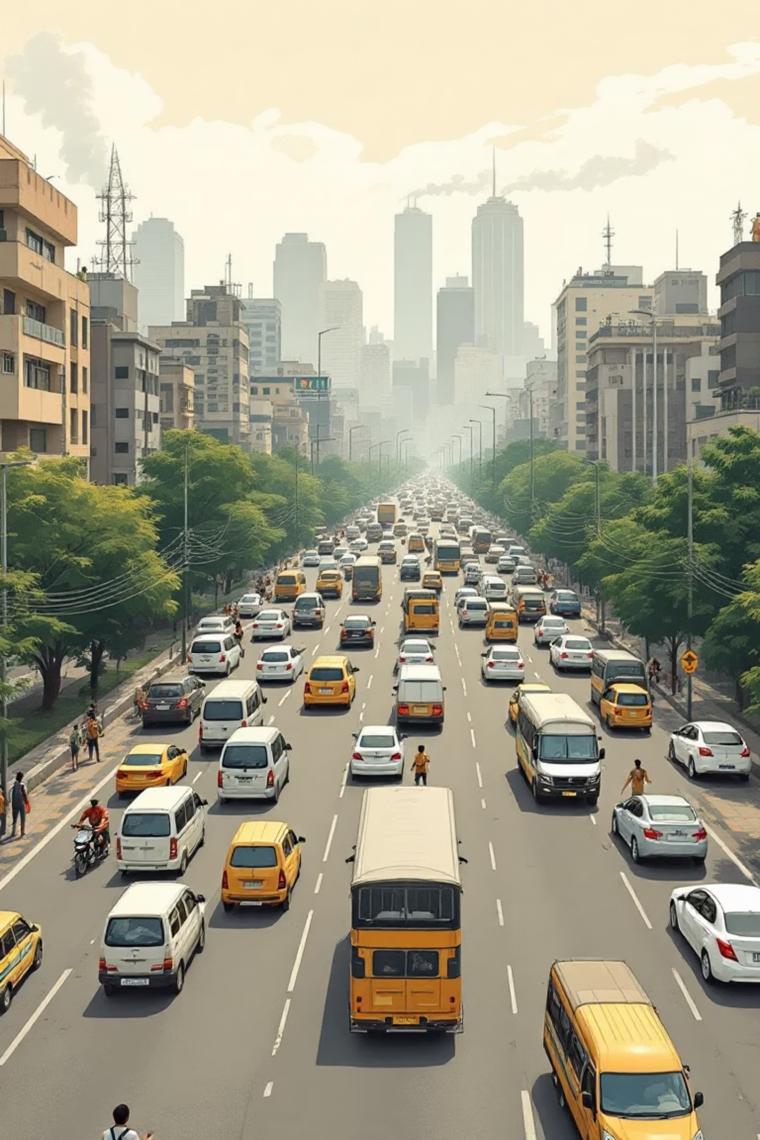
The Challenge We Face
Growing Health Emergency
Air pollution threatens millions across urban and industrial India
Monitoring Air Quality Index (AQI) is essential for protecting public health and informing policy decisions
Project Goals
Analyze month-wise AQI patterns nationwide
Identify pollution hotspots by region
Track dominant pollutants
Enable data-driven environmental policy

Slide 3
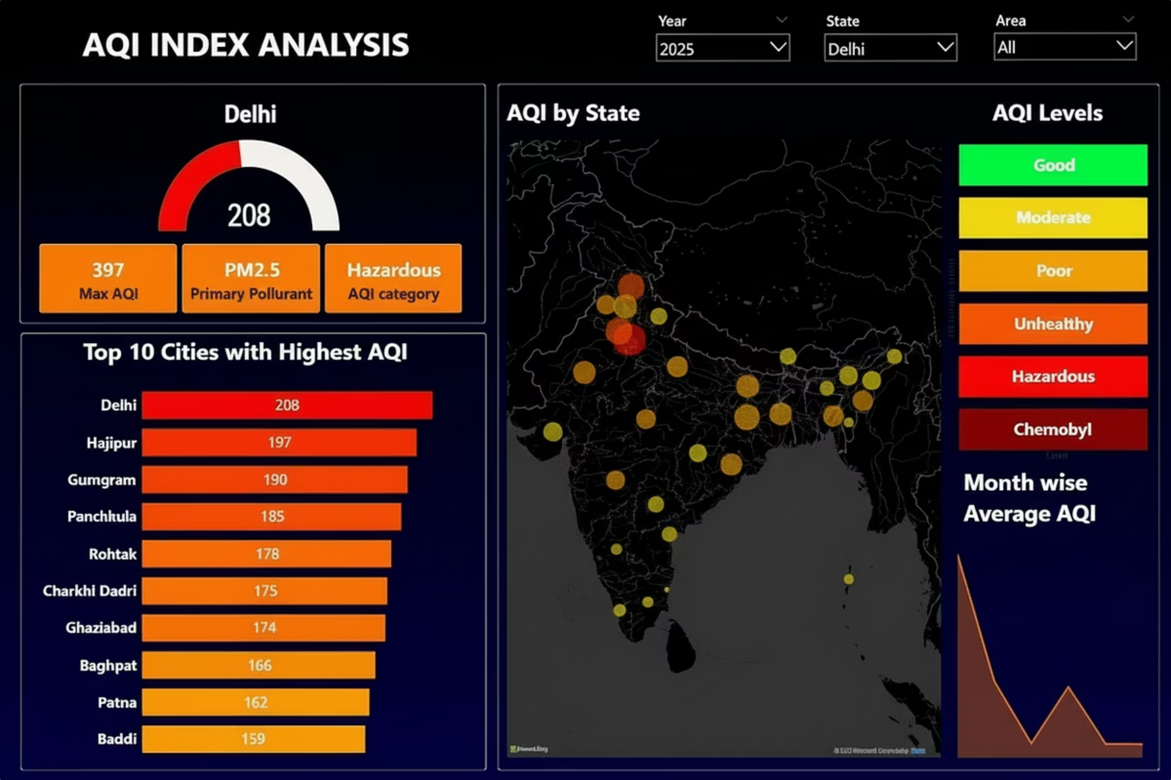



Dashboard Overview
Interactive Power BI platform integrating comprehensive AQI data
Day-Wise Data
Dynamic Filtering
Aggregated across states, cities, and time periods for deep analysis
Interactive slicers: Year, State, Area for customized views
Visual Analytics
Geographic maps, trend lines, and Top 10 rankings

Slide 4
Key Performance Indicators
208
PM2.5
10
Average AQI
Primary Pollutant
Top Cities
Delhi–NCR region shows hazardous levels
Fine particulate matter dominates across regions
Most polluted urban areas identified and tracked

Slide 5

Delhi–NCR Pollution Emergency
Hazardous Category
Average AQI of ~208 poses severe health risks
Regional Dominance
Multiple NCR cities rank in Top 10 most polluted
Persistent Crisis
Year-round elevated levels demand urgent action

Slide 6



PM2.5 Health Threat
85%
2.5
1st
Days Above Safe Levels
Micron Size
Primary Pollutant
PM2.5 consistently exceeds WHO guidelines
Fine particles penetrate deep into lungs
Identified across all major urban centers
PM2.5 poses the greatest health risk, causing respiratory and cardiovascular diseases

Slide 7
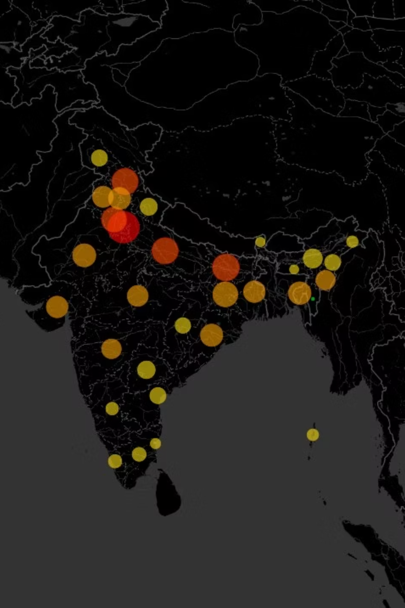
Geographic Distribution
Northern Concentration
North and North-Central India show significantly higher AQI levels
Industrial corridors
Dense urban populations
Weather patterns trap pollutants
Southern Contrast
Southern regions maintain relatively better air quality
Lower industrial density
Coastal wind circulation
Green cover advantages

Slide 8

Seasonal Patterns
Month-wise AQI reveals significant fluctuation driven by multiple factors
1
Oct–Nov Peak
Stubble burning, Diwali firecrackers, temperature inversion
2
Winter Surge
Dec–Jan see trapped emissions, heating, low wind speeds
3
Monsoon Relief
Jul–Aug show improvement due to rainfall washing pollutants
4
Summer Variation
Mar–May: dust storms, heat contribute to moderate levels

Slide 9
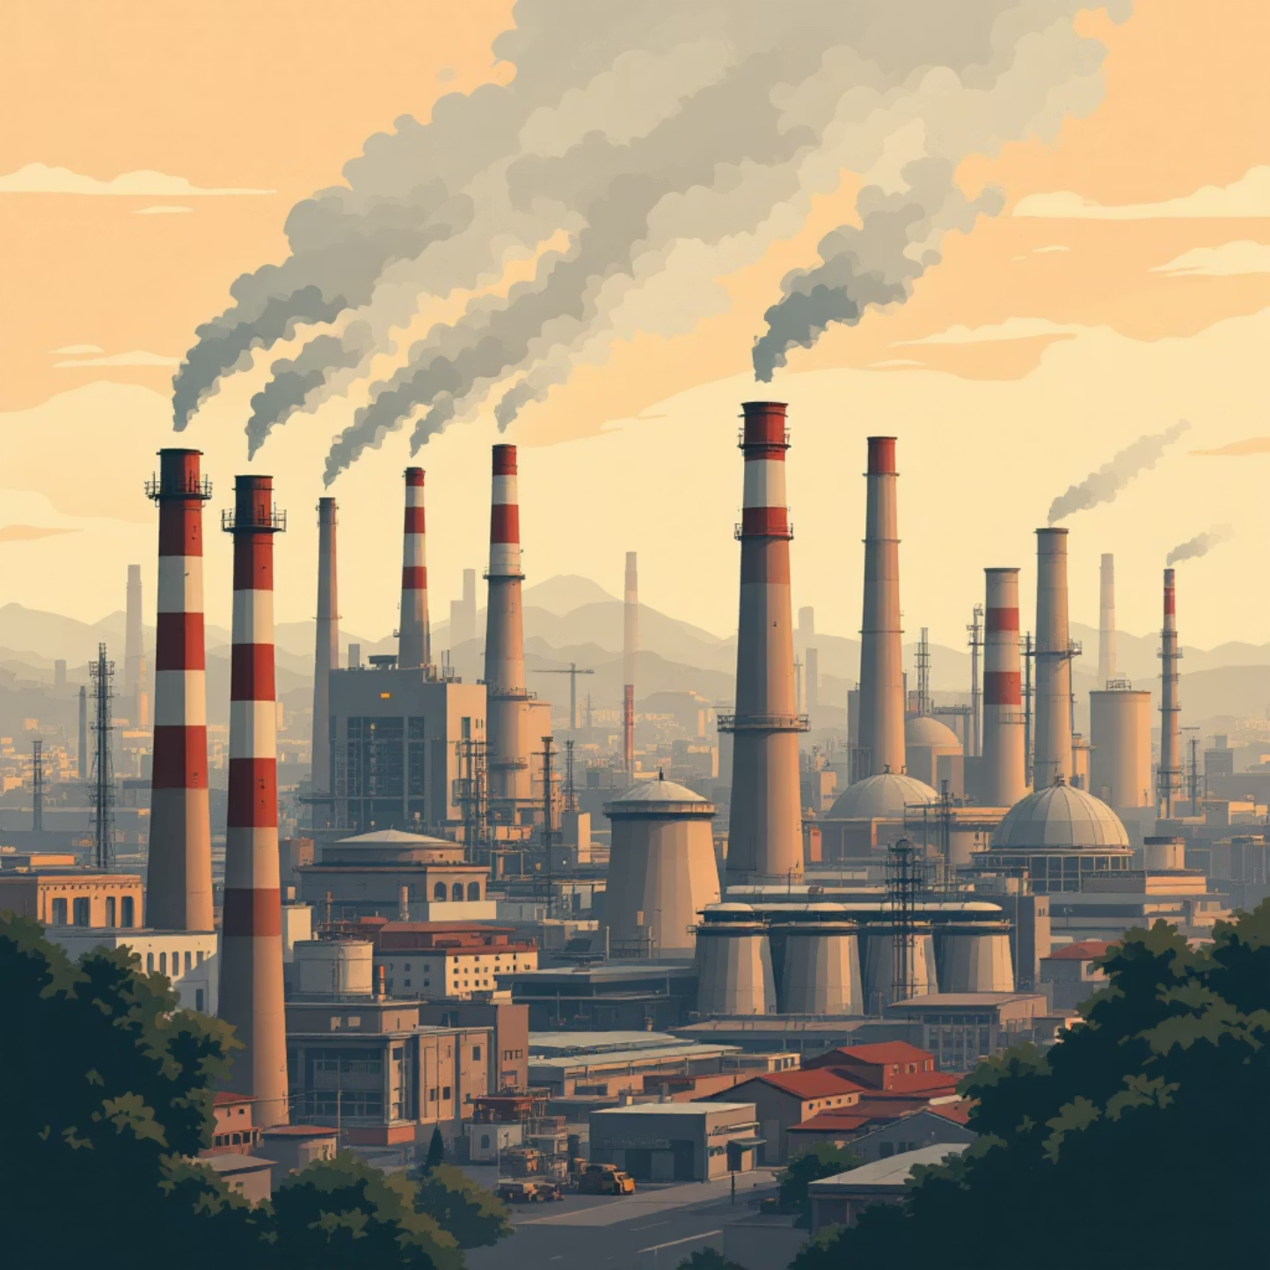
City-Level Disparities
Uneven Distribution
AQI varies dramatically within states, highlighting need for localized interventions
Industrial cities show 2-3x higher AQI
State averages mask critical hotspots
City-specific factors dominate patterns

Slide 10




Moving Forward
Targeted Action
Seasonal Planning
Evidence-Based Policy
Focus resources on identified hotspots
Preventive measures before peak months
Data-driven environmental regulations
The AQI Analysis dashboard demonstrates how business intelligence tools transform environmental data into actionable insights. Delhi-NCR remains the epicenter of India's air quality crisis, requiring coordinated action across government, industry, and communities to protect public health.

